Slide 1


Greetings to Direct Club

Slide 2

A system that also supports “downward”
What does membership bring you?
Access to benefits and opportunities in Direct Club
The potential to improve your household budget
Gradual familiarization with the system of bonuses and support
Support through webinars, workshops, and training sessions

Slide 3
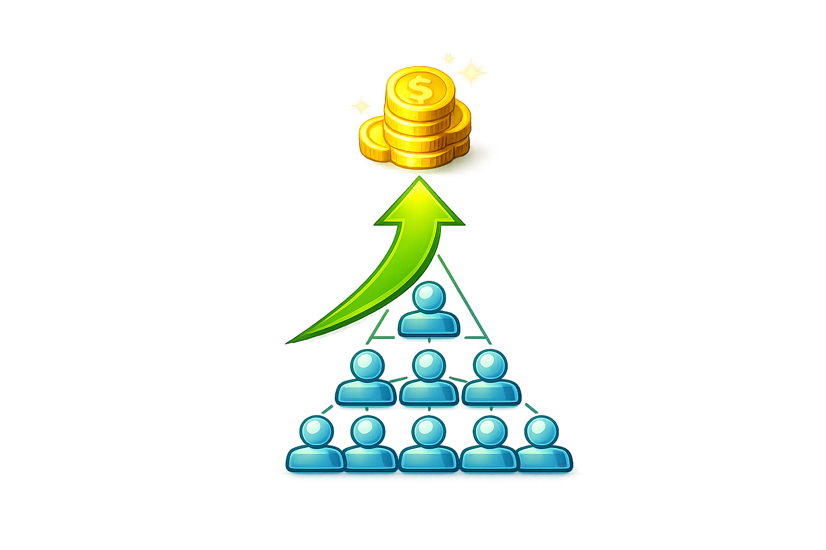

How is it elsewhere?
A bonus is created only after your activity (purchase/order).
And/or after the activity of people in the structure below you.
So: the reward typically “grows from the bottom.”

Slide 4

With us, it’s different: support also from your referrer
You can receive financial bonuses from the person who referred you.

Slide 5
With us, it’s different: support also from your referrer
You can receive financial bonuses from the person who referred you.

Slide 6
And even from up to 10 people above you.

Slide 7
Entry works by referral
You become a member/partner through a referral.
Everyone has someone above them who recommended the membership.
Above you, there is a direct line of referrers.

Slide 8
How bonuses are passed on
When a referrer earns bonuses…
They receive a bonus for their own activities and the activities of their organization.
They pass on part of those bonuses to the people they referred into membership.
And also further down into the structure below them (up to the 10th level).

Slide 9

What do you get out of it?
You can receive financial support from people in the direct line above you.
Condition: activate your entitlement with a simple step (we’ll show it right away).
You start with no pressure: Direct Club FREE membership is free.

Slide 10



What you don’t have to do
You don’t have to buy anything.
You don’t have to place any orders.
You don’t have to pay anything.
You just need to do one simple thing.

Slide 11
Refer one new member
On www.direct.club, copy your registration link.
Use the link to register 1 member / company.
Done — your entitlement is activated.
TY!

Slide 12
What happens?
You gain entitlement to support from 3 people above you:
Your direct referrer
  And the next 2 above them
YOU!

Slide 13
Do you want support from 6 people above you?
Refer a total of 3 people / companies.
→ You unlock support from 6 referrers in the line above you.
YOU!

Slide 14
Support from up to 10 referrers
Refer a total of 5 people / companies.
→ You unlock support from up to 10 referrers above you (if they exist).
YOU!

Slide 15

If there aren’t 10 people above you yet
Maybe you joined very early (and that’s an advantage).
It can happen that the structure doesn’t yet have 10+ levels above you.
But it means one thing:
you have a better position to build your own structure below you

Slide 16
Do this for your people too
Send this principle to everyone you register:
Everyone will want to activate support from their referrers.
You’ll help them quickly understand the first step.
You’ll speed up the start of your entire structure.

Slide 17
Thank you!

